Slide 1
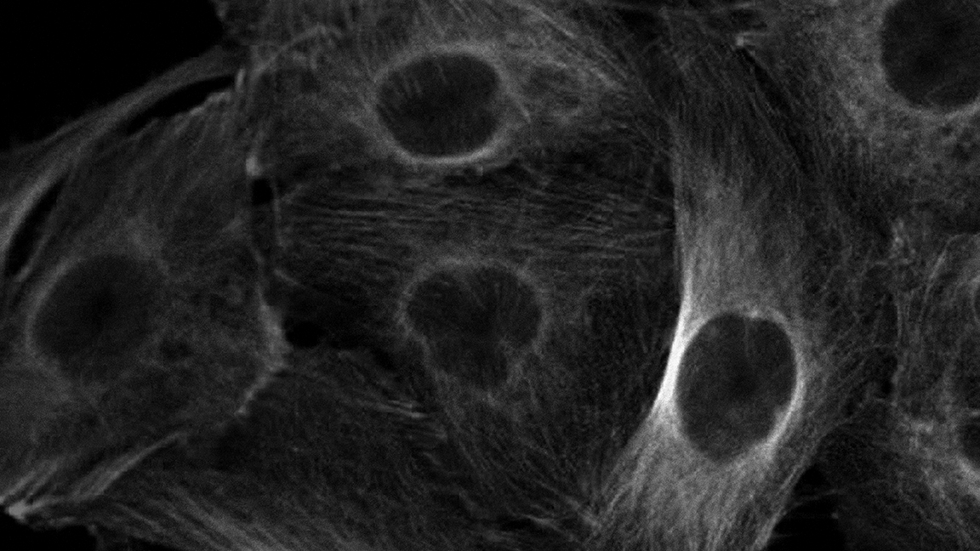

Cancer Biology Program
Douglas R. Green, PhD
Richard W. Kriwacki, PhD

Slide 2
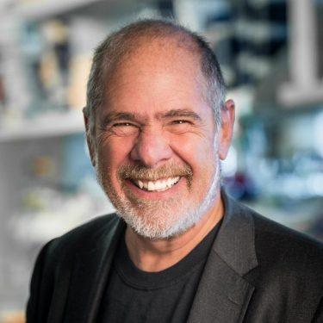
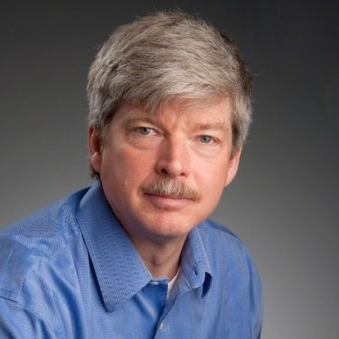
Program Leadership
Douglas Green, PhD
Richard Kriwacki, PhD
Co-Leader since 2016
Co-Leader since 2019
Chair, Dept of Immunology
Peter C. Doherty Endowed Chair of Immunology
Member, NAS
Oncogene EIC 2009-2016
NIH merit awards, 2002, 2017
NCI funded since 1994
Member, Dept of Structural Biology
Pioneer in studies of disordered proteins since 1996
Associate Editor Journal of Molecular Biology since 2014
Organizer of NCI-hosted and other conferences on phase separation
NCI funded since 2001
Current NCI funding:
R01CA169291
R35CA231620 (pending)
Current NCI funding:
R01CA246125
U54CA243124

Slide 3
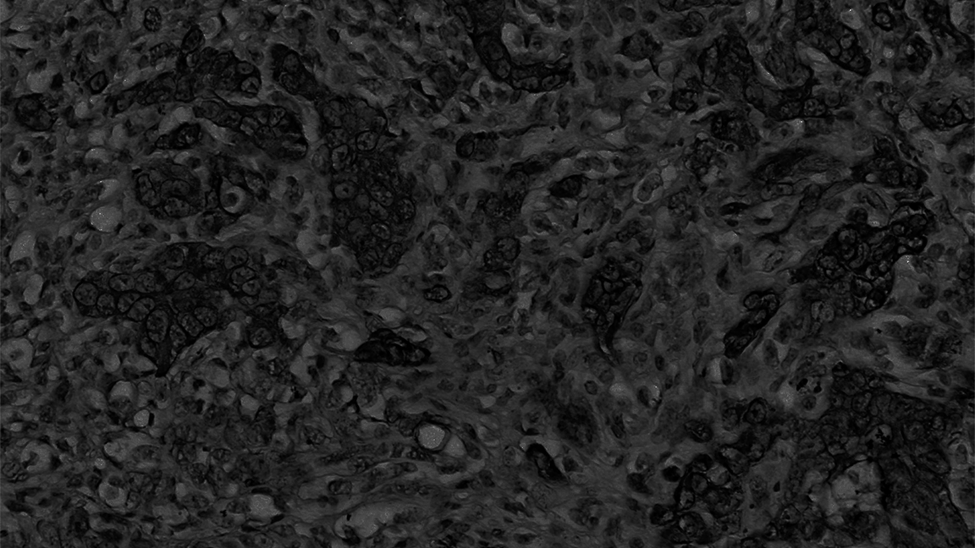
Program Goal
The overarching goal of the Cancer Biology Program (CBP) is to explore and understand the cell and molecular biology of cancer and, whenever possible, to apply basic knowledge to improve the health of children with cancer.

Slide 4
Specific Aims
To understand the signaling pathways that underlie cancer initiation, progression, and metastasis & identify new targets for therapy
To investigate how fundamental processes of cell survival and repair are commandeered by cancer cells
To identify and define the functions of immune and other cells of the tumor microenvironment, and how they affect and are affected by that environment
To characterize the genomic and epigenomic landscape of cancer and how it impacts both the cancer cell and its microenvironment

Slide 5
Key Metrics
Comparison of Cancer-Relevant Funding
(Direct Costs in $M)
Membership:
32 Members (28 Full; 4 ECI-Associate)
10 Departments
Original Research Publications
(July 1, 2019 – June 30, 2020): 91 total
49% Inter-programmatic
13% Intra-programmatic
48% Impact factor ≥ 10

Slide 6
Scientific highlights
Today, we present three research areas that are subject of recent publications that highlight:
Innovation in an emerging field, biomolecular condensation;
Success of an Early Career Investigator supported by Developmental Funds in the field of chromatin biology; and
Highly collaborative, population-based tumor suppressor biology with significant translational implications.

Slide 7
Scientific Highlights from Working Groups - #1
Wilson Clements
Marcus Fisher
Babis Kalodimos
Richard Kriwacki
Esther Obeng
Stacey Ogden
Charles J. Sherr
Jiyang Yu
Gerard P. Zambetti
Scott Blanchard
Eric Enemark
Shannon McKinney-Freeman
Tudor Moldoveanu
Joseph Opferman
Linda Hendershot
Richard Lee
Brenda Schulman
Yongqiang Feng
Hans-Martin Herz
Chunliang Li
Xiaotu Ma
Tanja Mittag
Andrew Murphy
Martine F. Roussel
Anang Shelat
Jinghui Zhang
Hongbo Chi
Sandra D’Azzo
Stephen Gottschalk
Douglas Green
Thirumala-Devi Kanneganti
Notes:
2 working groups focused on each of our specific aims. These groups are designed to cover the breadth of modern cancer discovery research. Each week one member of a working group presents a 30 minute overview of an aspect of their research program, and invites a second researcher to give a related presentation to explore possible interactions.
For example, in a recent meeting
Dr. Richard Kriwacki, a structural biologist,

Slide 8
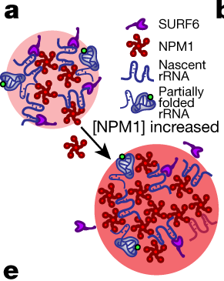
Composition-dependent thermodynamics of intracellular phase separation (collaboration with Cliff Brangwynne, Princeton)
The nucleolus is a liquid-like membraneless organelle and the protein NPM1 organizes key steps of ribosome biogenesis via liquid-liquid phase separation.
Investigator:
Kriwacki
[Cancer Biology]
Funding:
R01GM115634, R35GM131891 & P30CA021765
Shared Resources:
Cell and Tissue Imaging, Center for Proteomics and Metabolomics,
Hartwell Center for Biotechnology
Key Publications:
Riback J, et al., Nature, 2020; Mitrea, et al., Nat. Commun., 2019.
Cancer cells generally display numerous and large nucleoli, driven in part by overexpression of NPM1.
NPM1 overexpression enhances the capacity of nucleoli to produce ribosomes, sustaining the cancer phenotype.
These findings suggest new directions for anti-cancer therapeutics that target biomolecular condensates like the nucleolus.

Slide 9
Scientific Highlights from Working Groups - #2
Wilson Clements
Marcus Fisher
Babis Kalodimos
Richard Kriwacki
Esther Obeng
Stacey Ogden
Charles J. Sherr
Jiyang Yu
Gerard P. Zambetti
Scott Blanchard
Eric Enemark
Shannon McKinney-Freeman
Tudor Moldoveanu
Joseph Opferman
Linda Hendershot
Richard Lee
Brenda Schulman
Yongqiang Feng
Hans-Martin Herz
Chunliang Li
Xiaotu Ma
Tanja Mittag
Andrew Murphy
Martine F. Roussel
Anang Shelat
Jinghui Zhang
Hongbo Chi
Sandra D’Azzo
Stephen Gottschalk
Douglas Green
Thirumala-Devi Kanneganti
Notes:
2working groups focused on each of our specific aims. These groups are designed to cover the breadth of modern cancer discovery research. Each week one member of a working group presents a 30 minute overview of an aspect of their research program, and invites a second researcher to give a related presentation to explore possible interactions.
For example, in a recent meeting
Dr. Richard Kriwacki, a structural biologist,

Slide 10
Acute depletion of CTCF directly affects MYC regulation through loss of enhancer–promoter looping
Dr. Li stablished a cellular knock-in model allowing acute depletion of the endogenous DNA looping protein, CTCF, via an auxin-inducible degron system.
Investigator:
Li (Early Career Investigator)
[Cancer Biology]
Funding:
P30CA021765 (Dev Funds), R01CA216391
Shared Resources:
Flow Cytometry, Cytogenetics Lab,
Hartwell Center
Key Publications:
Hyle J, et al., Nucleic Acids Res., 2019.
Zhang Y, et al., PNAS., 2019
CTCF defines TAD boundaries and facilitates the formation of insulated loop structures within chromatin.
Acute loss of CTCF in a Myc-driven human pediatric MLLr B-ALL cell line, SEM, preferentially caused reduced Myc expression through disruption of DNA loop-mediated enhancer/promoter interactions in the Myc locus.
These results highlight the importance of 3D chromatin architecture in the regulation of Myc expression in MLLr leukemia.
Notes:
,

Slide 11
Scientific Highlights from Working Groups - #3
Wilson Clements
Marcus Fisher
Babis Kalodimos
Richard Kriwacki
Esther Obeng
Stacey Ogden
Charles J. Sherr
Jiyang Yu
Gerard P. Zambetti
Scott Blanchard
Eric Enemark
Shannon McKinney-Freeman
Tudor Moldoveanu
Joseph Opferman
Linda Hendershot
Richard Lee
Brenda Schulman
Yongqiang Feng
Hans-Martin Herz
Chunliang Li
Xiaotu Ma
Tanja Mittag
Andrew Murphy
Martine F. Roussel
Anang Shelat
Jinghui Zhang
Hongbo Chi
Sandra D’Azzo
Stephen Gottschalk
Douglas Green
Thirumala-Devi Kanneganti
Notes:
2working groups focused on each of our specific aims. These groups are designed to cover the breadth of modern cancer discovery research. Each week one member of a working group presents a 30 minute overview of an aspect of their research program, and invites a second researcher to give a related presentation to explore possible interactions.
For example, in a recent meeting
Dr. Richard Kriwacki, a structural biologist,

Slide 12
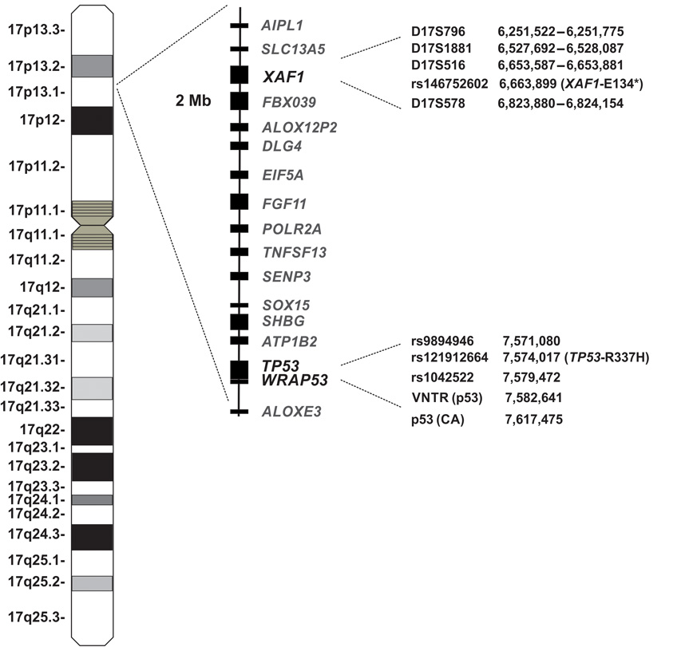
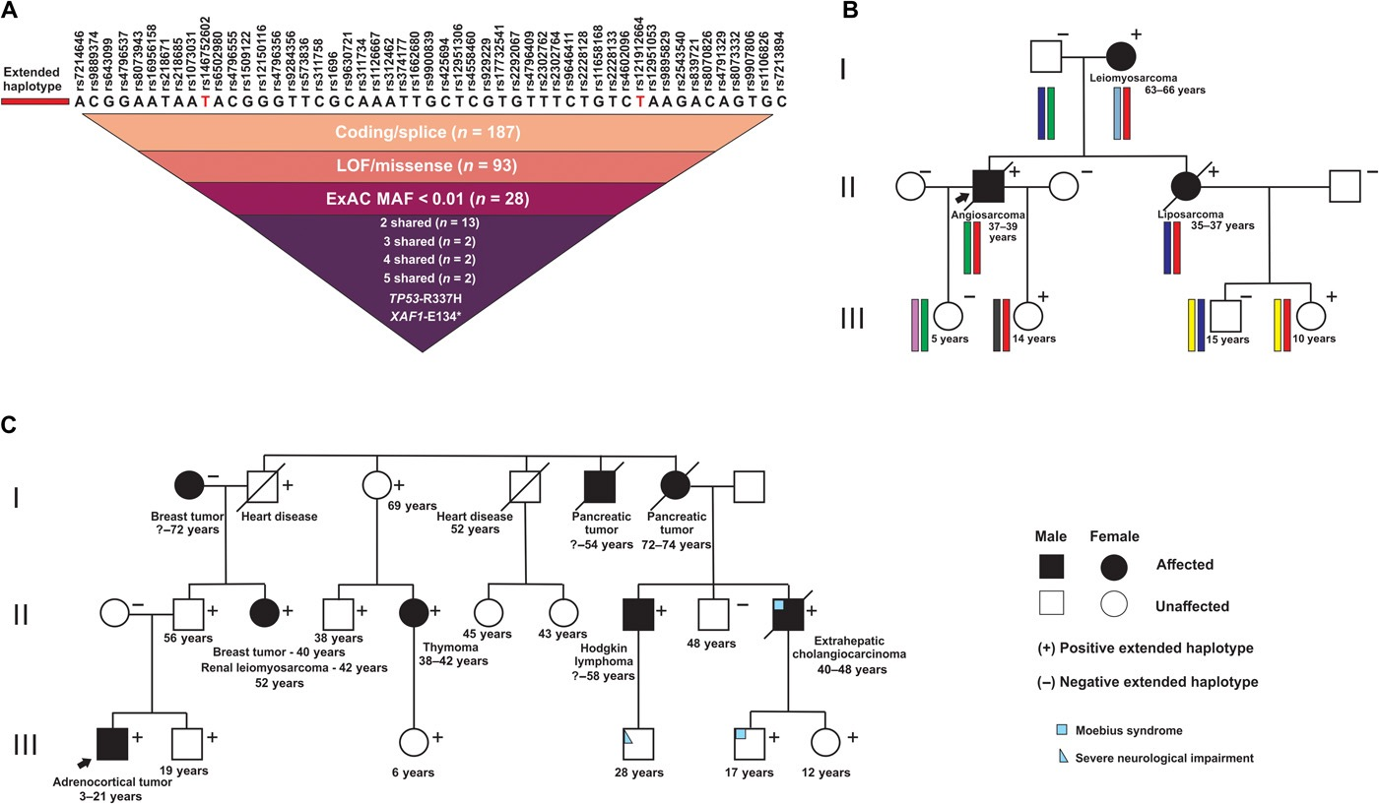
XAF1 as a modifier of p53 function and cancer susceptibility
The TP53-R337H allele common in Brazil predisposes children to adrenal cortical tumors and adult carriers to a variety of cancers.
Collaborators:
Zambetti, Zhang, Murphy, Pappo, Ribeiro, Rodriguez-Galindo
[Cancer Biology, Developmental Biology & Solid Tumor Program, Hematological Malignancies]
Funding:
P30CA021765, R01CA260175 (pending)
Shared Resources:
CAGE, Functional Genomics, Cytogenetics and Sanger Sequencing
Key Publication:
Pinto, et al., Sci. Advances, 2020
A variant in the tumor suppressor XAF1 (E134*/Glu134Ter) was identified in a subset of TP53-R337H carriers.
Importantly, the compound mutant haplotype conferred risk for sarcoma and subsequent malignancies.
I
These observations have implications for genetic counseling and clinical management of hypomorphic TP53 mutant carriers, in particular for TP53-R337H carriers in Brazil and elsewhere.

Slide 13
New initiatives & future plans
Leverage success of the 2020 annual CBP retreat to promote multi-investigator team science
  Hold the second retreat in 2021 (after COVID restrictions are lifted)
  Feature trainee lectures and interactive, team-building exercises
Promote career development of CBP trainees
  Hold quarterly “Research Rodeos” with three non-faculty speakers during the weekly meeting time
  Tailored for senior trainees to hone presentation skills and receive feedback
Enhance communication with membership regarding program goals & initiative
  Publish a biannual CBP newsletter, occasionally discuss CBP & Cancer Center matters at the beginning of the weekly meeting

Slide 16
Scientific Highlights from Working Groups - #1
Wilson Clements
Marcus Fisher
Babis Kalodimos
Richard Kriwacki
Esther Obeng
Stacey Ogden
Charles J. Sherr
Jiyang Yu
Gerard P. Zambetti
Scott Blanchard
Eric Enemark
Shannon McKinney-Freeman
Tudor Moldoveanu
Joseph Opferman
Linda Hendershot
Richard Lee
Brenda Schulman
Yongqiang Feng
Hans-Martin Herz
Chunliang Li
Xiaotu Ma
Tanja Mittag
Andrew Murphy
Martine F. Roussel
Anang Shelat
Jinghui Zhang
Hongbo Chi
Sandra D’Azzo
Stephen Gottschalk
Douglas Green
Thirumala-Devi Kanneganti
Notes:
working groups focused on each of our specific aims. These groups are designed to cover the breadth of modern cancer discovery research. Each week one member of a working group presents a 30 minute overview of an aspect of their research program, and invites a second researcher to give a related presentation to explore possible interactions.
For example, in a recent meeting
Dr. Richard Kriwacki, a structural biologist,

Slide 17
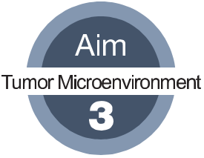
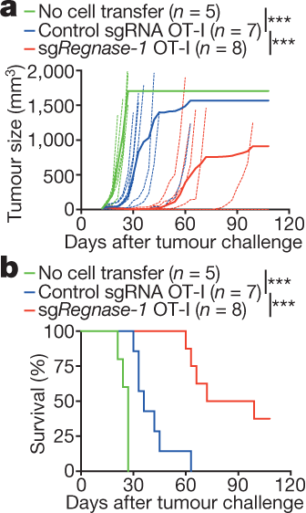
Targeting REGNASE-1 programs long-lived effector T cells for cancer therapy
Knock-out of REGNASE-1 reprograms CD8⁺ T cells to long-lived effector cells with extensive accumulation, better persistence and robust effector function in tumors.
Collaborators:
Chi, Geiger, Yu
[Cancer Biology]
Funding:
AI105887, AI131703, AI140761, AI150241, AI150514, & CA221290
Shared Resources:
Bionf. & Biotech, Center for Proteomics and Metabolomics,
Veterinary Pathology Core, Hartwell Center for Biotechnology,
Animal Resources Center
Key Publication:
Wei J, et al., Nature, 2019.
REGNASE-1-deficient CD8⁺ T cells show markedly improved therapeutic efficacy against mouse models of melanoma and leukemia.
These findings suggest that T cell persistence and effector function can be coordinated in tumor immunity and point to avenues for improving the efficacy of adoptive cell therapy for cancer.

